Slide 1
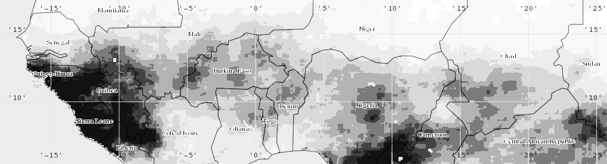
VIC MODEL OVERVIEW
Kel Markert
NASA-SERVIR Mekong Regional Associate
University of Alabama in Huntsville | Earth System Science Center
6 March 2017

Slide 2
OUTLINE
Hydrology model comparison/selection
VIC model features
Cell size
Sub-grid representations
VIC model processes
Vegetation
Snow
Evapotranspiration
Runoff/Infiltration
Baseflow
Routing Model

Slide 3
THE VIC MODEL
The Variable Infiltration Capacity (VIC) Model
Grid-based land surface representation
Simulates land surface-atmosphere fluxes of moisture and energy
Developed for coupled Land Surface Model (LSM) – Global Circulation Model (GCM) simulations
Considered a research model
Open-source development
Image from Open Access VIC Documentation: http://vic.readthedocs.io/en/master/Overview/ModelOverview/

Slide 4
LSM - TRADITIONAL HYDRO MODEL DIFFERENCE
 | Traditional Hydrology Model | LSM Scheme
Purpose | Flood forecasting, water supply | For inclusion in a GCM as a land surface scheme
Fluxes | Only water balance in important | Both water and energy balance is important
Model representation | Mainly conceptual models (parameters are not physically based such as the CN method) | More physically based formulation (e.g. hydraulic conductivity)
Vegetation | Implicitly simulated | Explicitly simulated
Run | Lumped parameters or fully distributed | Grid-based
Function | Off-line simulations | Dynamic coupling with GCM or off-line simulations

Slide 5
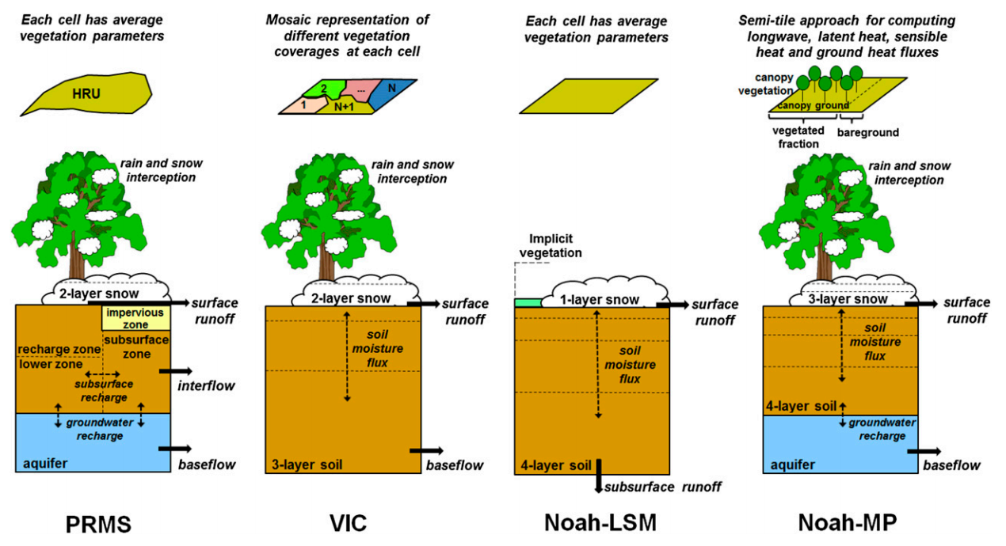
HYDROLOGY MODEL SELECTION
Model selection depends largely on application of model
Somewhat based on technical expertise
Many studies have investigated model selection, parameterization, and calibration effects on results
Model selection has a major effect
Should understand model components and physical representations for application
Mendoza et al., 2015 (Open access J. Hydromet. Article): http://journals.ametsoc.org/doi/pdf/10.1175/JHM-D-14-0104.1

Slide 6
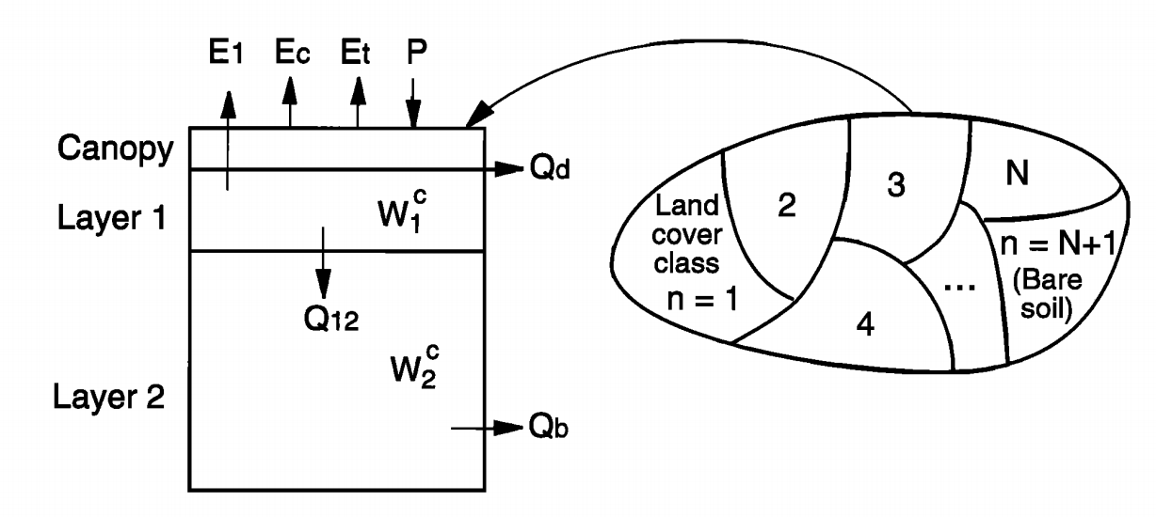
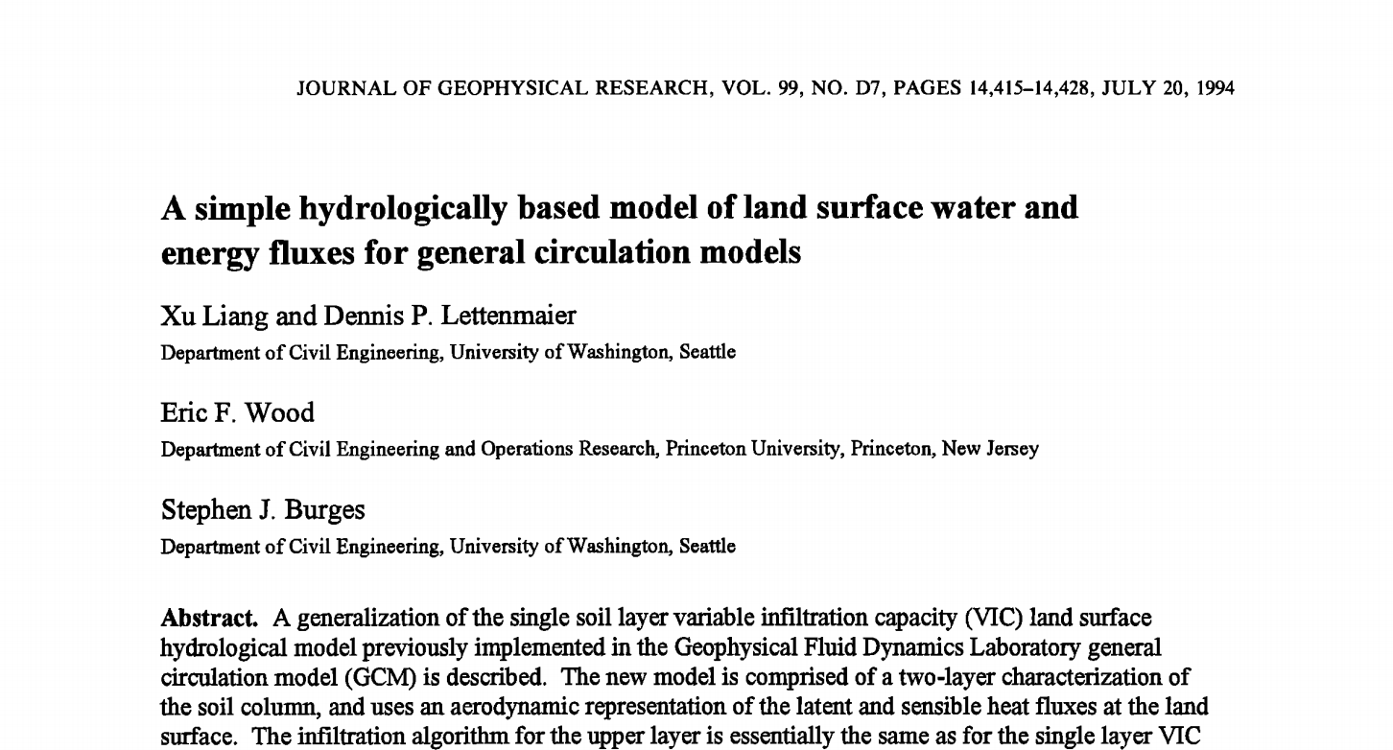
Origins of VIC
Developed by Liang et al. [1994]
Two-layer soil-vegetation model
Physically-based model to be coupled with climate models
Image from Liang et al. [1994] (Open access article):
http://onlinelibrary.wiley.com/doi/10.1029/94JD00483/epdf

Slide 7
VIC FEATURES
Each grid cell is simulated independently
Only water entering cell is from atmosphere
Can represent sub-grid vegetation/land cover
Can represent sub-grid elevation variability (snow bands)
Daily or sub-daily time step
Multiple soil layer depths
Routing of streamflow is performed independently using a separate model
Typically the Lohmann et al. [1996; 1998] routing model
Deep groundwater is not considered within the model

Slide 8
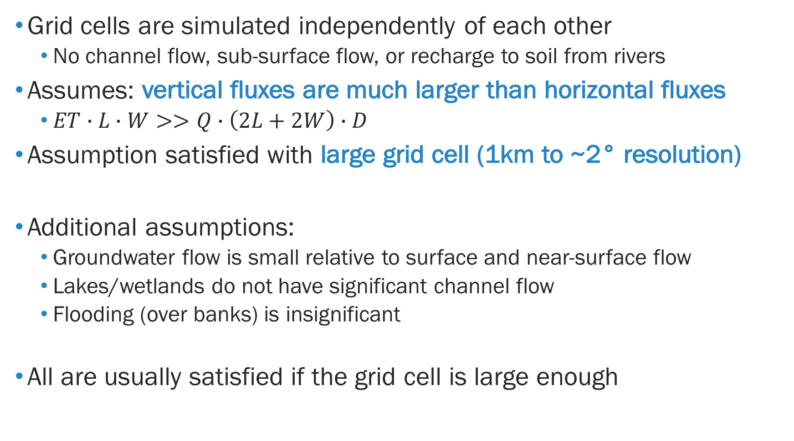
VIC GRID CELL SIZE
Grid cells are simulated independently of each other
No channel flow, sub-surface flow, or recharge to soil from rivers
Assumes: vertical fluxes are much larger than horizontal fluxes
$ET∙L∙W>>Q∙\left(2L+2W\right)∙D$
Assumption satisfied with large grid cell (1km to ~2° resolution)
Additional assumptions:
Groundwater flow is small relative to surface and near-surface flow
Lakes/wetlands do not have significant channel flow
Flooding (over banks) is insignificant
All are usually satisfied if the grid cell is large enough

Slide 9
SUB-GRID REPRESENTATION: VEGETATION
Spatial distribution and parameters for vegetation classes are specified within input files
Energy and water balance terms are computed independently for each vegetation class
Each class has different parameterization:
Leaf-area index
Rooting depth
Surface roughness
etc.
Classes must add up to 100% area or VIC’s bare soil scheme is used for the remainder
Example: 33% Forest, 36% Grassland
(100 – 33 – 36 = 31% bare soil)
Image from Open Access VIC Documentation: http://vic.readthedocs.io/en/master/Overview/ModelOverview/

Slide 10
SUB-GRID REPRESENTATION: ELEVATION
Simulates orographic effects on precipitation/snowfall and snow pack processes
Important for representing the differences in snow accumulation and snow melt timing between high and low elevations
User specified snow (elevation) bands
Factional area and mean elevation for each band
Mean pixel temperature is lapsed to each elevation band
Precipitation falls as either liquid or solid depending on the lapsed temperature
Image from Open Access VIC Documentation: http://vic.readthedocs.io/en/master/Overview/ModelOverview/

Slide 11
SUB-GRID REPRESENTATION: AGGREGATION
Sub-grid processes are combined through weighted areal average
Computed by elevation bands and then vegetation cover
Order of operations is important
Band 1
Band 2
.
.
Band N
More elevation bands and vegetation types significantly increase computation time!
Veg 1
.
.
Veg N
Veg 1
.
.
Veg N
Veg 1
.
.
Veg N
Weighted areal average by variable
Final model output value for grid cell

Slide 12
HYDROLOGIC PROCESS REPRESENTATION
Requires detailed parameterization
Important for climate-sensitive regions
Contains modules and options to capture specific processes
https://science.nasa.gov/earth-science/oceanography/ocean-earth-system/ocean-water-cycle

Slide 13
VEGETATION CANOPY
Canopy evap (wet canopy or snow)
Transpiration (dry canopy)
Precipitation
Canopy storage
(determined by LAI)
Canopy “throughfall” occurs when additional precipitation exceeds the canopy storage capacity in the current time step
Image from Open Access VIC Documentation: http://vic.readthedocs.io/en/master/Overview/ModelOverview/

Slide 14
SNOW SIMULATIONS
Snow within the vegetation canopy is directly related to LAI
Uses two-layer energy balance model at snow surface
Thin surface layer
Pack layer
Albedo and snow pack size evolves with snow ages
Requires calibration of snow surface roughness
New Snow
New Snow
New Snow
Compressed Snow
Compressed Snow
Old Snow
Time 1
Time 2
Time 3

Slide 15
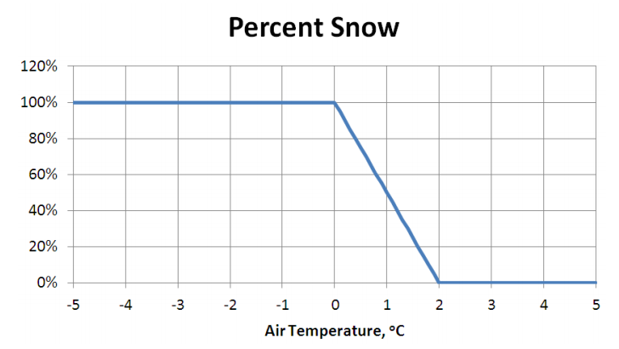
RAIN-SNOW PARTITIONING
VIC used a simple (linear) method to determine the percentage of liquid (rain) or solid (snow) precipitation
Example: Rain Minimum = 0.0 °C
Snow Maximum = 2.0 °C
Requires calibration of the rain minimum and snow maximum parameters
For this example, 0.5°C would produce
75% snow and 25% rain

Slide 16
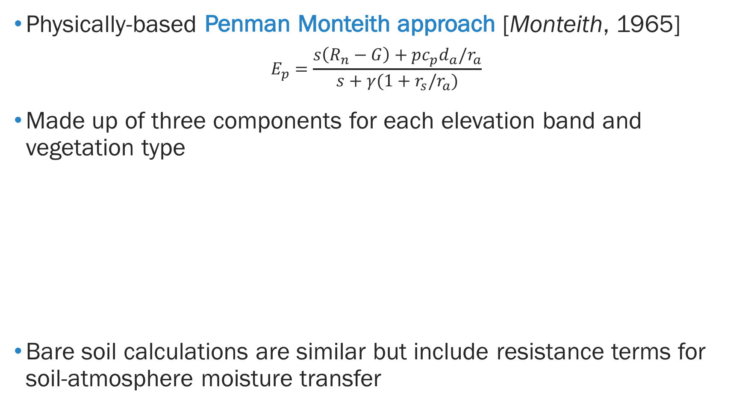
EVAPOTRANSPIRATION SIMULATION
Physically-based Penman Monteith approach [Monteith, 1965]
$$E_{p}=\frac{s\left(R_{n}−G\right)+pc_{p}d_{a}/r_{a}}{s+γ(1+r_{s}/r_{a})}$$
Made up of three components for each elevation band and vegetation type
Bare soil calculations are similar but include resistance terms for soil-atmosphere moisture transfer
Wet canopy evaporation
ET
Dry canopy transpiration
Bare soil surface evaporation

Slide 17
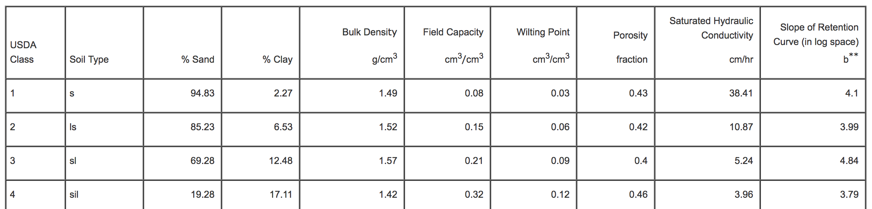
PARAMETERIZATION OF SOILS
Soil information is poorly known
Pedotransfer functions
Changing what we have into what we need
Soil texture info to physical units
Soil pedotransfer table
Soil texture information is used to estimate:
Porosity
K_{sat}
Field capacity
Wilting point
Residual capacity
And other soil characteristics
Image in public domain: https://commons.wikimedia.org/wiki/File:SoilTexture_USDA.png

Slide 18
SOIL COLUMN
Parameterize arbitrary number of soil layers at different depths
Model requires at least two soil layers for water balance calculations and three soil layers for energy balance calculations
No theoretical limit to number of layers
Typically, three layers are defined for simulations
NLDAS VIC 3 Layers (approx. 0-0.15, 0.15-0.55, and 0.55-1.35 meters)
GLDAS VIC 3 Layers (0-0.1, 0.1-1.6, and 1.6-1.9 meters)
Infiltration and surface runoff
~ 0.1 m
Interflow processes
~ 0.2-0.5 m
Baseflow processes
Adjust lower layer depths during calibration
~ 0.7-1.5 m

Slide 19
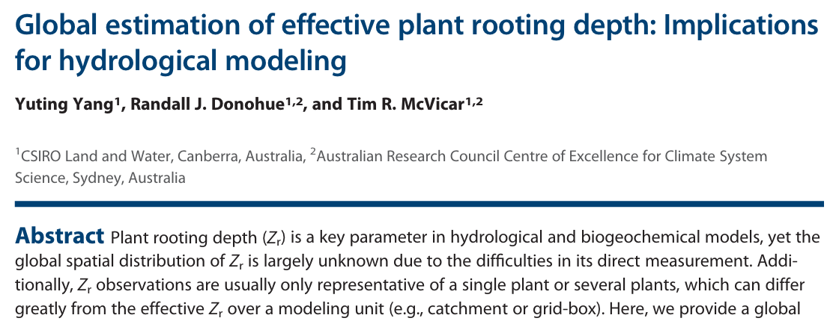
ROOTING DEPTHS
Rooting depths are independent of soil layer depths
Rooting depths and distributions are user-defined
Defined for each vegetation type in each grid cell
Important parameterization for vegetation transpiration calculations
Determines available water at soil depths for uptake by vegetation
Rooting parameterization taken from literature or estimated
Image from Open Access VIC Documentation: http://vic.readthedocs.io/en/master/Overview/ModelOverview/

Slide 20
RUNOFF-SOIL INFILTRATION
Surface runoff/soil infiltration defined by the variable infiltration curve [Wood et al., 1992]
Scales maximum infiltration with a non-linear function of fractional saturated area
Enables runoff calculations for subgrid-scale areas
Curve shape defined by b_{inf} parameter (typically >0 - ~0.4)
Amount of infiltration capacity relative to the saturated gridcell area
Greater value of b_{inf} yields lower infiltration and more runoff (Q_{d})
Image from Open Access VIC Documentation: http://vic.readthedocs.io/en/master/Overview/ModelOverview/

Slide 21
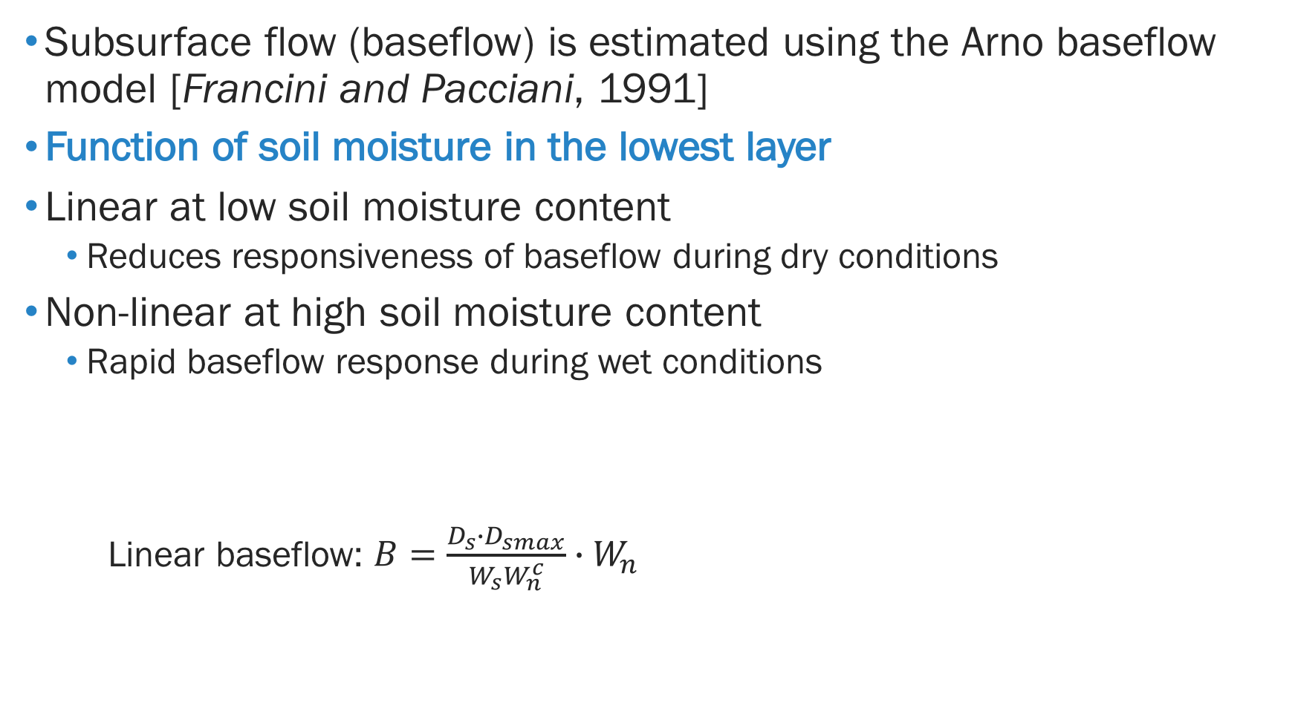
SOIL DRAINAGE
Subsurface flow (baseflow) is estimated using the Arno baseflow model [Francini and Pacciani, 1991]
Function of soil moisture in the lowest layer
Linear at low soil moisture content
Reduces responsiveness of baseflow during dry conditions
Non-linear at high soil moisture content
Rapid baseflow response during wet conditions
Linear baseflow: $B=\frac{D_{s}∙D_{smax}}{W_{s}W_{n}^{c}}∙W_{n}$
Image from Open Access VIC Documentation: http://vic.readthedocs.io/en/master/Overview/ModelOverview/

Slide 22
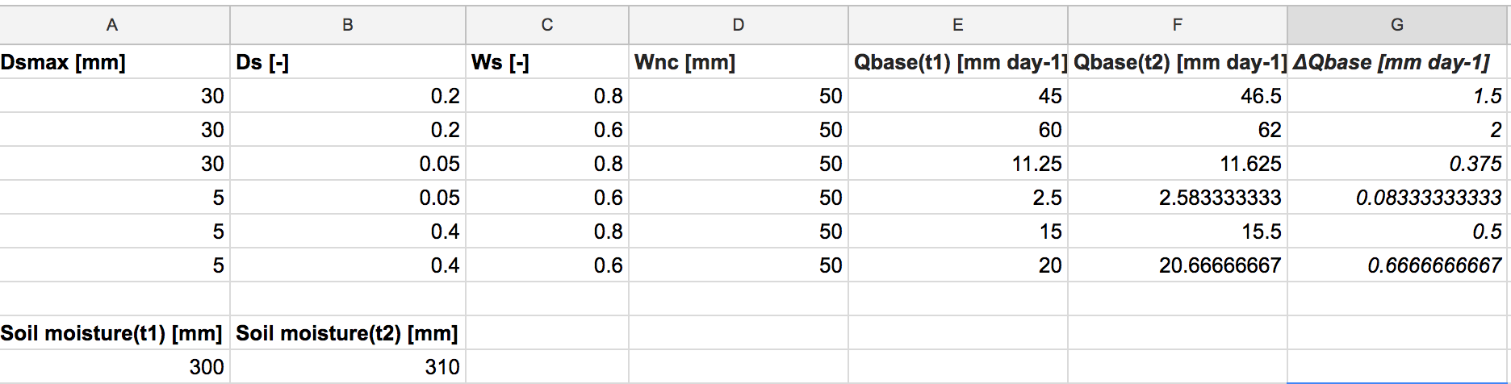
BASEFLOW FORMULATION
Important to understand baseflow dynamics and parameterization for calibration
Baseflow calculation example: https://goo.gl/5qFCKM
Assume one time step (t1 to t2) and the lowest layer’s soil moisture increases from 300 to 310 mm. Find the change in baseflow for the time step using different parameterization
Change model parameters to for different results
W_{n}^{c} (or W_{s}, D_{smax}) parameters defined by soil parameters
W_{n}^{c} = porosity * soildepth

Slide 23
STREAMFLOW ROUTING
Streamflow routing performed after LSM scheme simulations
Developed specifically to be coupled with LSM [Lohmann et al., 1996; 1998]
Grid-based routing scheme based on the unit hydrograph approach
Solves lumped linearized time-invariant Saint-Venant equations to create the Impulse Response Functions (IRF) for each grid
Image from Open Access VIC Documentation: http://vic.readthedocs.io/en/master/Overview/ModelOverview/

Slide 24
COMPUTATIONAL CONSIDERATIONS
Compiled using free GNU C compilers
Can use other compilers but needs to be tested
Simulation runs cell by cell, can be very efficiently parallelized by dividing the domain into separate runs
VIC is typically run using UNIX/LINUX operating systems
Possible to run using Windows OS but not supported
Simulations usually use about 5 MB of RAM
Usage does not increase with basin size!
Need considerable amount of storage for I/O data
Dependent on basin size, time step, etc.

Slide 25
VIC RESOURCES
Old VIC website: http://www.hydro.washington.edu/Lettenmaier/Models/VIC/Overview/ModelOverview.shtml
Current VIC website: http://vic.readthedocs.io/en/master/
Routing model website: http://rvic.readthedocs.io/en/latest/
VIC GitHub: https://github.com/UW-Hydro/VIC
RVIC GitHub: https://github.com/UW-Hydro/RVIC/

Slide 26
REFERENCES
Francini, M., and M. Pacciani, (1991) Comparative analysis of several conceptual rainfall-runoff models, J. Hydrol., 122, 161-219
Liang, X., D. P. Lettenmaier, E. F. Wood, and S. J. Burges (1994), A simple hydrologically based model of land surface water and energy fluxes for general circulation models, J. Geophys. Res., 99, 14415-14428
Lohmann, D., R. Nolte-Holube, and E. Raschke, (1996), A large-scale horizontal routing model to be coupled to land surface parametrization schemes, Tellus, 48, 708-721.
Lohmann, D., E. Raschke, B. Nijssen and D. P. Lettenmaier (1998), Regional scale hydrology: I. Formulation of the VIC-2L model coupled to a routing model, Hydrol. Sci. J., 43, 131-141.
Maurer, E. (2011), VIC Hydrology Model Training Workshop-Part I: About the VIC Model, Presentation, url: http://www.engr.scu.edu/~emaurer/chile/vic_taller/01_vic_training_overview_processes.pdf
Monteith, J. L. (1965), Evaporation and the environment, in The state of movement of water in living organisms, pp 205-234, 19th Symposia of the Society for Experimental Biology. Cambridge Univ. Press, London, UK
Wood, E. F., D. P. Lettenmaier, and V. G. Zartarian (1992), A land-surface hydrology parameterization with subgrid variability for general circulation models, J. Geophys. Res., 97, 2717-2728

Slide 27
BREAK
Kel Markert
kel.markert@nasa.gov

